Slide 1

Advancing Health: Our Drug Development Journey
Progress Update on the Pipeline
This presentation provides a concise overview of our significant achievements and ongoing progress in the drug development pipeline. We aim to highlight key milestones, the current status of our clinical trials, and our strategic next steps, making the complex journey of bringing a new medicine to patients clear and understandable for all stakeholders.

Slide 2
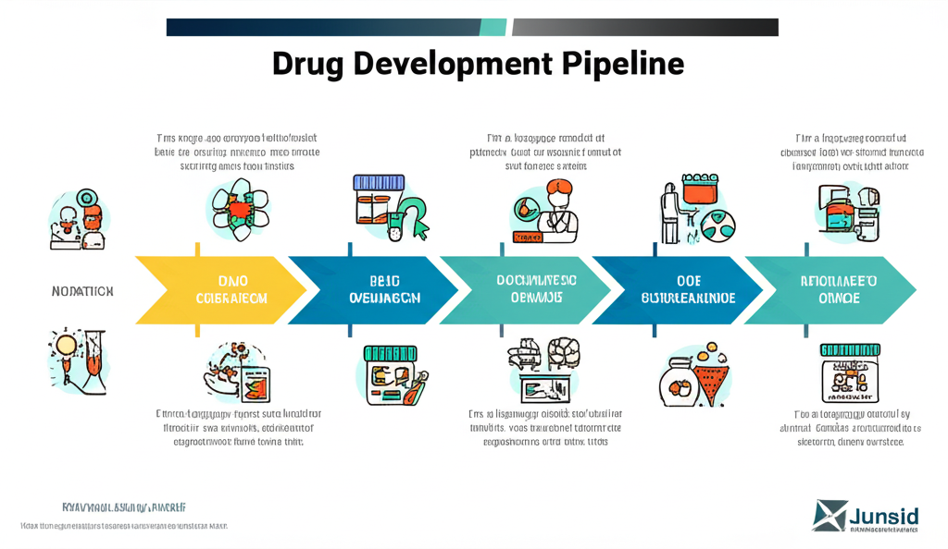
The Drug Development Pipeline: A Phased Approach
Discovery: Identifying promising compounds.
Preclinical: Testing in lab and animal models for safety and efficacy.
Clinical Trials (Phases 1-3): Human testing to confirm safety, dosage, and effectiveness.
Regulatory Review & Approval: Submitting data for market authorization.
Post-Market Surveillance: Ongoing monitoring after approval.

Slide 3

Early Success: Discovery and Preclinical Achievements
Our journey began with a highly successful Discovery phase, culminating in Q1 2024 with the identification of three promising lead compounds. This crucial stage laid the foundation for potential therapeutic breakthroughs. Following this, the Preclinical testing, completed by Q4 2024, yielded encouraging results, demonstrating favorable efficacy and safety profiles across various models. These early successes validate our research approach and provide strong momentum for moving into human trials.

Slide 4
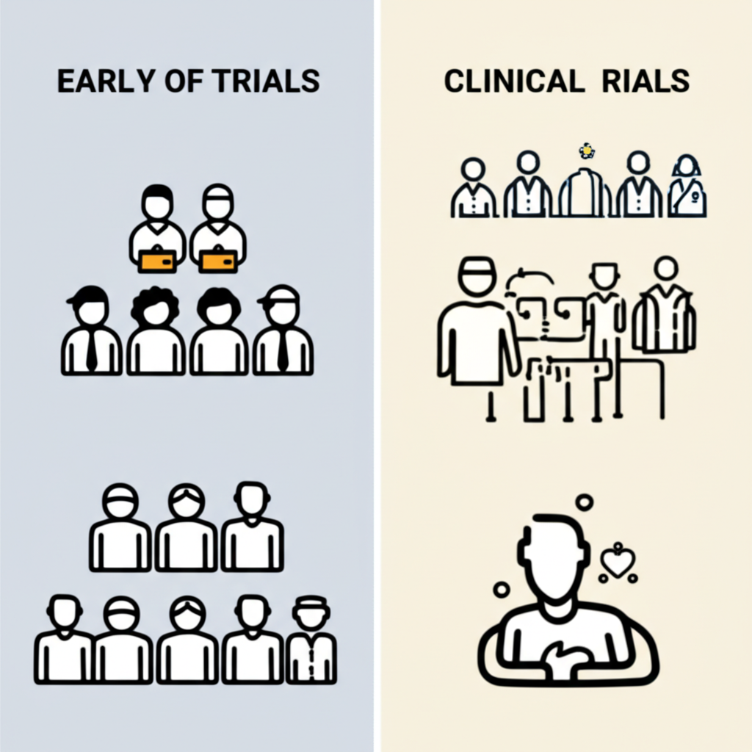
Navigating Clinical Trials: Phase 1 & 2 Progress
Phase 1: Safety & Tolerability
Launched Q1 2025 with 50 healthy volunteers.
Primary safety endpoints successfully met.
Established initial safe dosage range.
Phase 2: Dose Optimization & Efficacy
Currently underway (Q3 2025) with 120 patients.
Focusing on optimal dosing and preliminary efficacy.
Gathering critical data for larger Phase 3 trials.

Slide 5
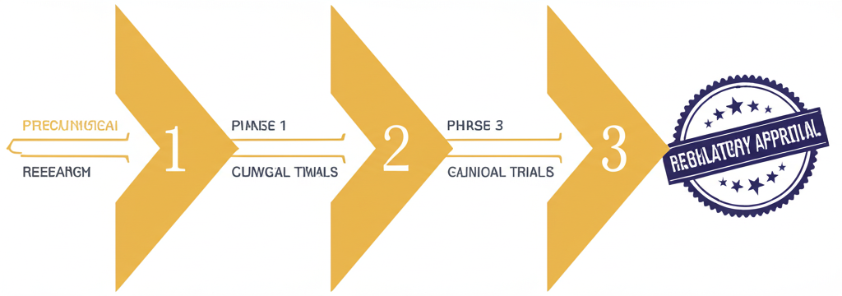
Looking Ahead: Next Steps and Regulatory Path
Building on our current progress, the next critical step is the completion of our Phase 3 clinical trial, which will provide definitive data on efficacy and long-term safety. Following successful Phase 3 results, we anticipate preparing and submitting our comprehensive regulatory application in Q2 2026. This submission marks a pivotal moment, bringing us closer to potentially delivering a new therapeutic option to patients in need and realizing our mission to improve global health.

